Slide 1


—
Enhanced agent workspace for messaging
Training: transitioning & using new features
LivePerson Proprietary & Confidential Information. © 2019 LivePerson, Inc. All Rights Reserved.

Slide 2



Why use the enhanced agent workspace?
Simple to use UI was designed with messaging in mind
Save time with the help of guided decision making
Filter out inactive conversations for a list that’s easier to work with

Slide 3
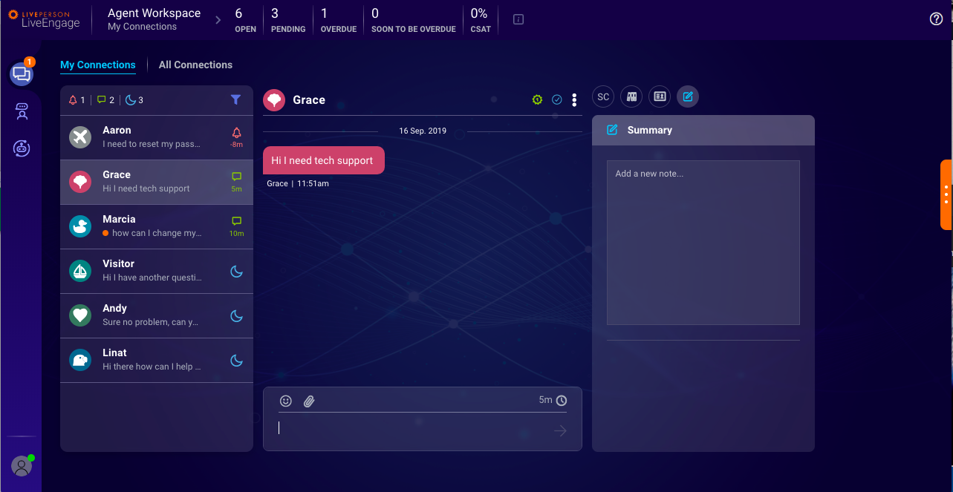
Introducing the enhanced agent workspace
The enhanced workspace is the perfect environment for handling messaging conversations. It features automation to streamline your work and is equipped with all of the tools needed to increase your focus and efficiency.

Slide 4
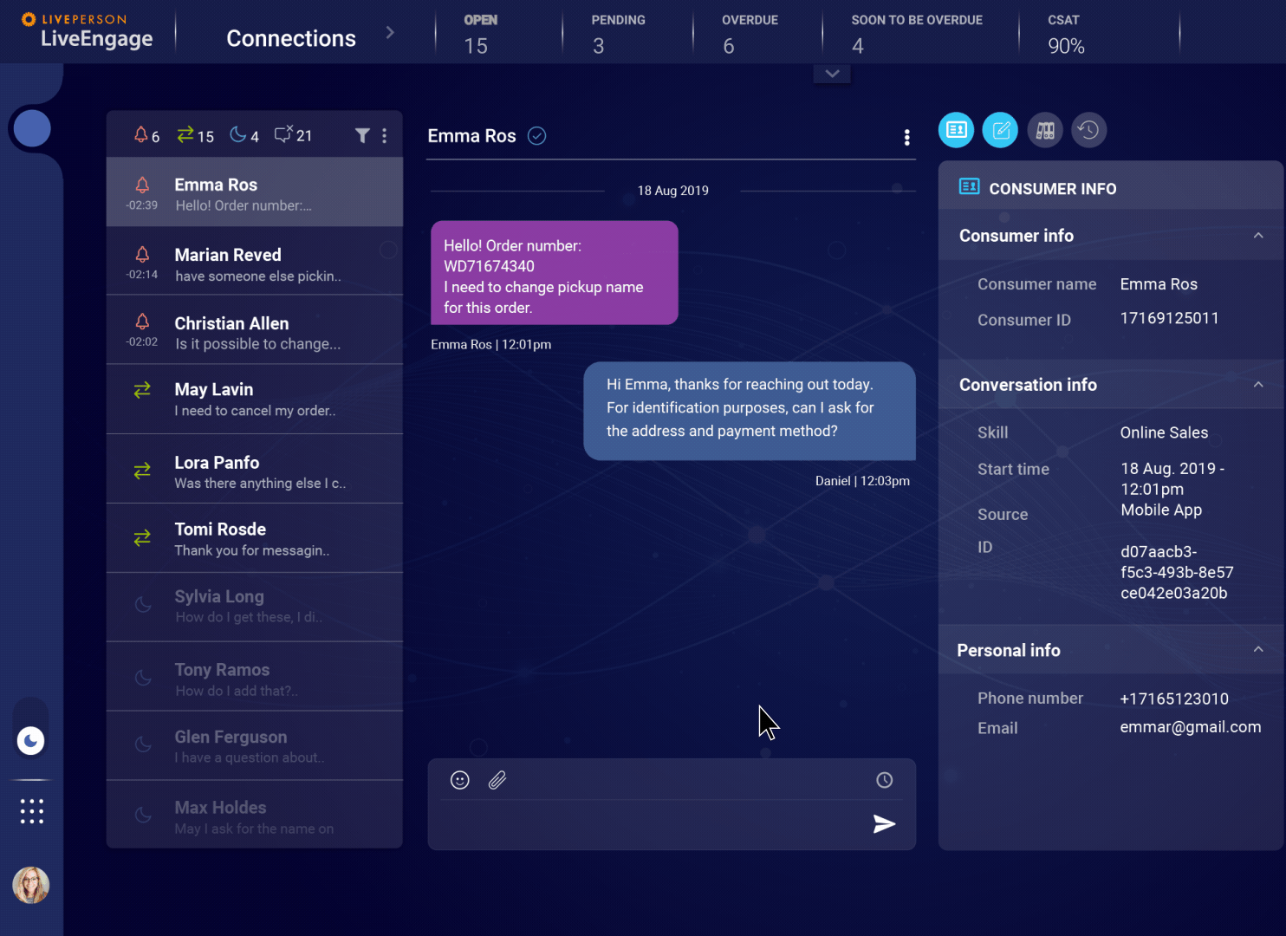
What’s new?
Updated look & feel
Guided decision making saves you time
Reduced noise in queue and increased agent focus
Faster shift wrap up with a quick view of closed conversations
Full history of the conversation within the same window
Quickly catch up on previous conversations with the same consumer
LivePerson Proprietary & Confidential Information. © 2019 LivePerson, Inc. All Rights Reserved.

Slide 5

Beginning of your shift
—

Slide 6
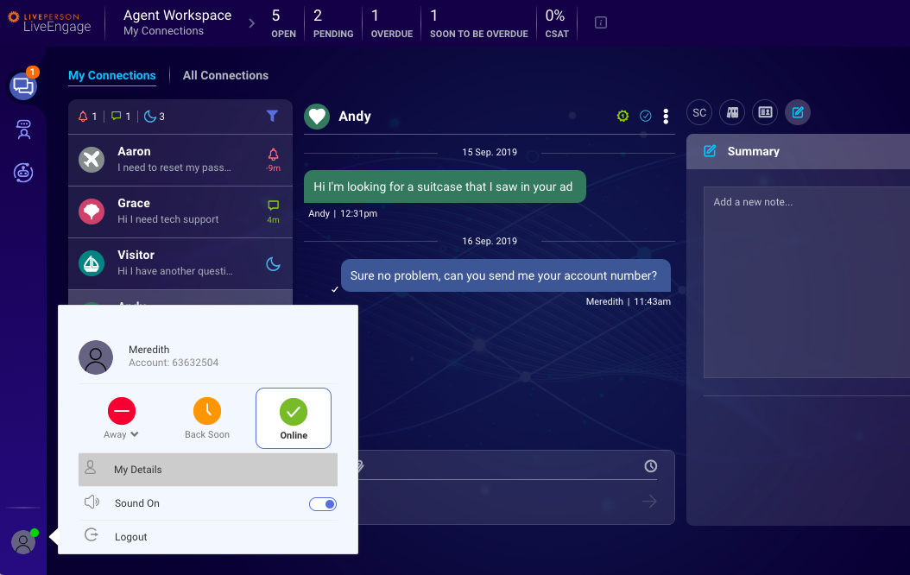
Update your status
To change your status and begin receiving conversations in your queue, click on your image in the bottom left hand corner to open the drop down status menu and select Online.
LivePerson Proprietary & Confidential Information. © 2019 LivePerson, Inc. All Rights Reserved.

Slide 7
Handling conversations:
Your workload simplified
—

Slide 8
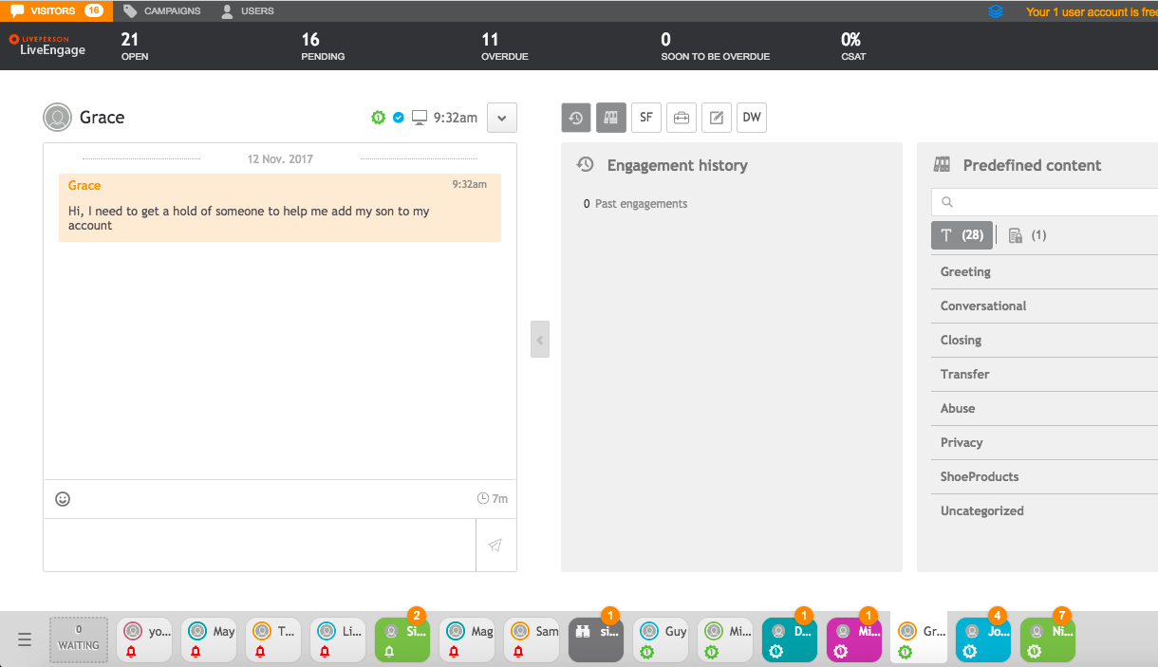
Current experience: Choosing which conversation to reply to next
The conversation list is not prioritized and you have to choose which conversation to answer next when dealing with many conversations at once. Do you answer the consumer that has sent the most messages? The one that has been waiting the longest?
Customer who is waiting the longest?
Most active customer?

Slide 9
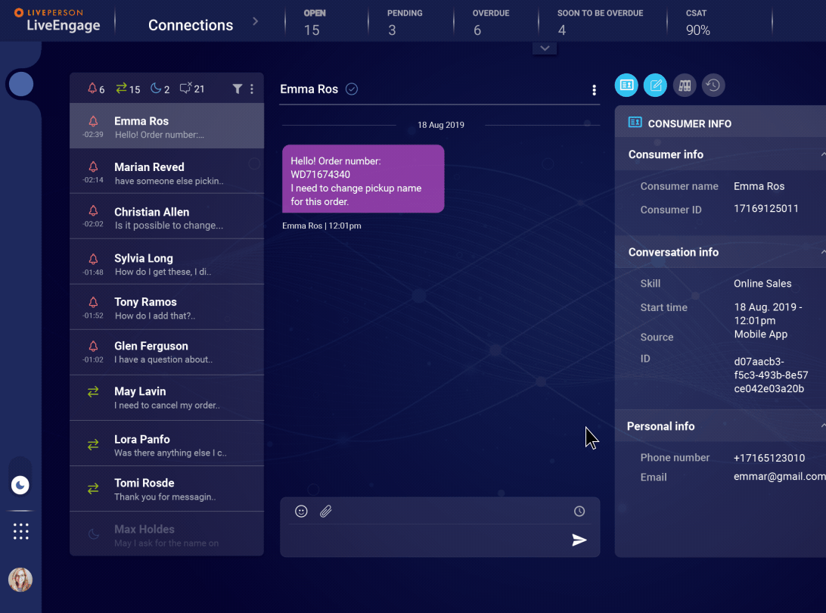
The enhanced workspace
saves you time through guided decision making
The new dynamic conversation list is automatically sorted so that the most urgent conversation will be at the top list.
The list is sorted by SLA, helping you to reduce guesswork and focus only on the conversation you need to.
You can still select conversations out of order that you would like to view or respond to.

Slide 10
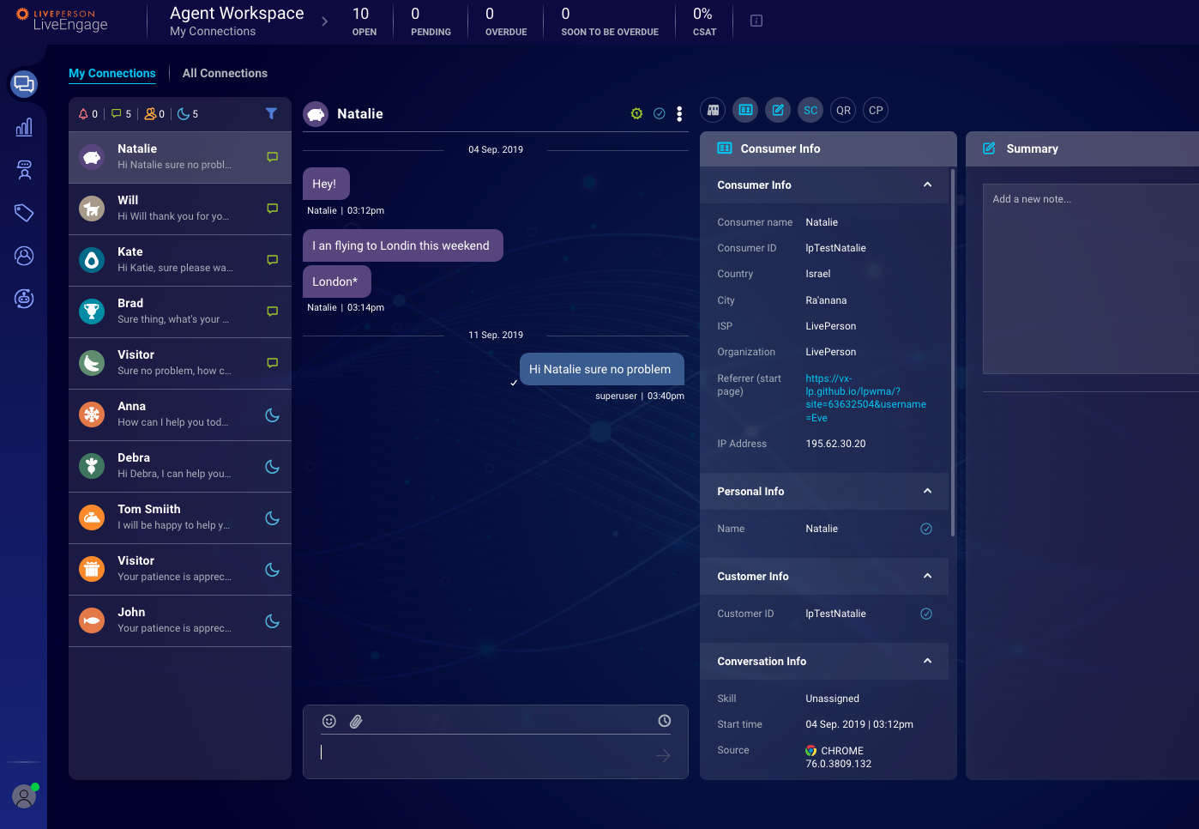
My Connections
The My Connections list includes all of the recent conversations that were assigned to you, including conversations that were recently closed.
You can work through your My Connections list from the top down, and filter closed conversations into the list at the end of your shift to ensure you documented everything properly.
*Please note: conversations are stored from 24 hours to up to 2 weeks in the My Connections tab, depending on the configuration of your contact center.

Slide 11
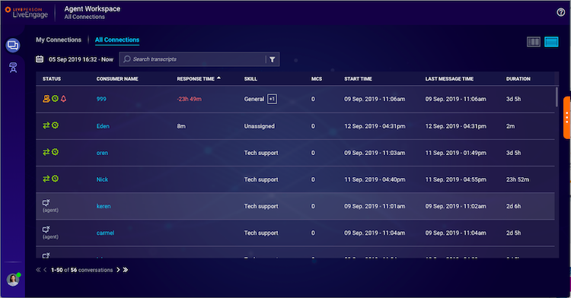
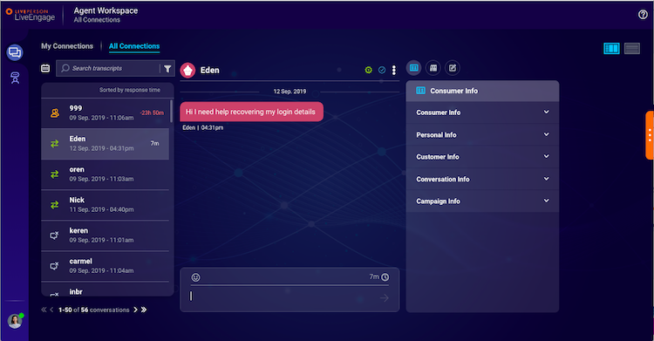
All Connections
If you have permissions to view the All Connections tab, it can be used to search for closed conversations that started within the past 13 months.
All Connections can be viewed in either ‘list mode’ or ‘conversation mode’ by selecting either of the icons in the top right corner. In list mode, you’ll see high-level information about each conversation. When you select a conversation from the list it will open in conversation mode where you can view the full transcript.

Slide 12
Incoming message notifications
You can see the number of incoming conversations in the navigation bar. A notification will appear on the Connections icon indicating the number of conversations with incoming messages, and an orange dot will appear on the conversation in the list that has a new incoming message.

Slide 13
Conversation statuses and filters
Status | Icon | Description | Use
Ongoing |  | Ongoing conversations are open conversations that are currently active. | These conversations are in the list by default and cannot be filtered out.
Overdue |  | Conversations that were not answered before the SLA has expired. | These conversations are in the list by default and cannot be filtered out.
Idle |  | Conversations in which the consumer hasn’t replied for 5 minutes or longer, defined as inactive. | These conversations are filterable. Filter them out of the list for a more succinct list of conversations that require urgent action.
Closed |  | Conversations that have been marked as ‘closed’ by you, by consumers, or have been automatically closed by the system due to timeout. | These conversations are filterable. Filter them into the list at the end of your shift, or if you have down time to review your documentation.

Slide 14
Keyboard shortcuts
Action | Hotkey
MOVE to the next prioritized conversation (NEW) | CTRL + ` + M
COPY as plain text (NEW) | CTRL + ` + C
ACCEPT a new incoming conversation | CTRL + ` + A
TRANSFER conversation to another skill (UPDATED) | CTRL + ` + E
Return conversation to the QUEUE | CTRL + ` + Q
CLOSE conversation | CTRL + ` + X
STATUS: toggle status between Online, Back Soon, and Away | CTRL + ` + S
LOGOUT of the agent workspace | CTRL + ` + L

Slide 15
Current experience: managing a long queue
The nature of messaging means that consumers don’t always answer immediately and many go idle. When dealing with a long list of assigned conversations - how do you keep track of which ones are active and require your attention?

Slide 16
Reduce noise by filtering out inactive conversations
Remain focused on active conversations by filtering out the idle ones.
The shorter conversation list will help you focus and maintain a strong handle on your workload.
Once a conversation becomes active again, it will automatically appear in the list.

Slide 17
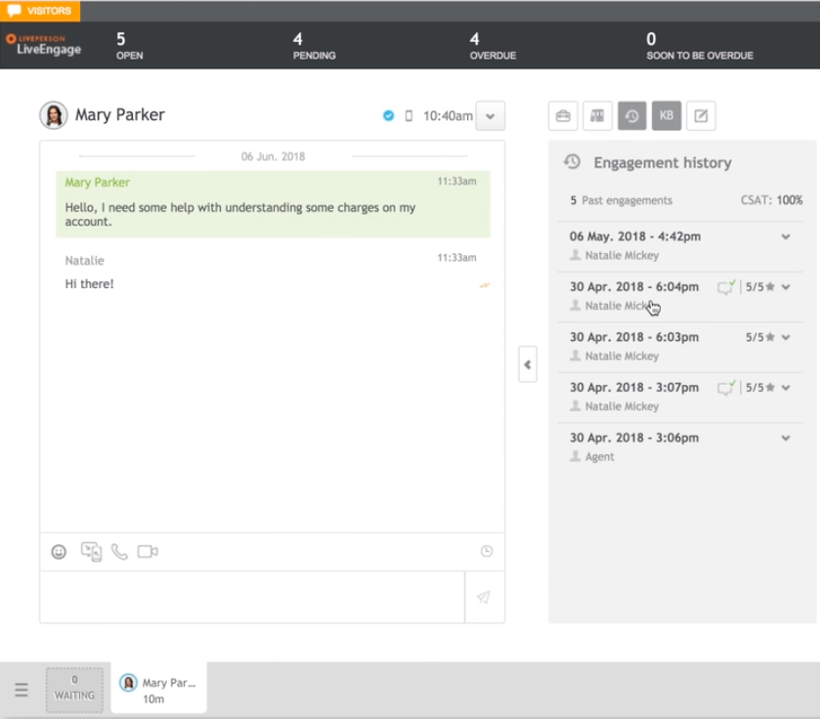
Current experience: conversation history can be overlooked
The previous conversations a consumer has had can have a great impact on how you start and carry out a conversation. Today, the history is displayed in a separate widget.

Slide 18
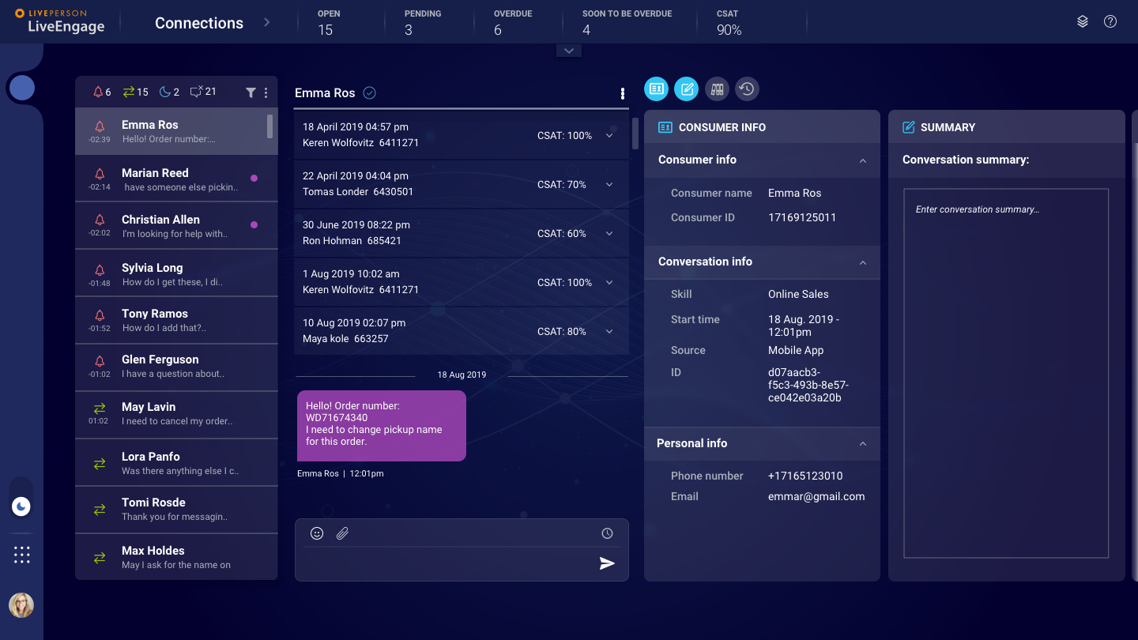
Continuous view of conversation history ensures you always have the full context
The conversation history now appears directly in the transcript, rather than in a dedicated widget. This allows you to simply scroll up and view all past interactions, as well as conversation info and CSAT.
LivePerson Proprietary & Confidential Information. © 2019 LivePerson, Inc. All Rights Reserved.

Slide 19
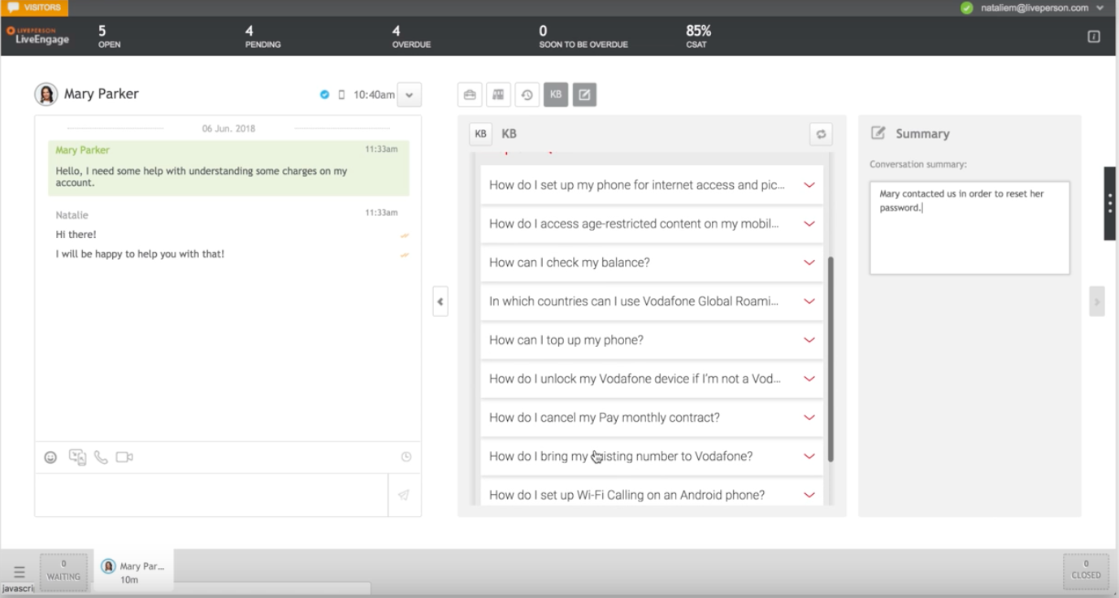
Current experience: limited to one conversation summary
Previously only one agent could submit a summary for the conversation, limiting the amount of information that could be passed to the agent who handles the conversation next.

Slide 20
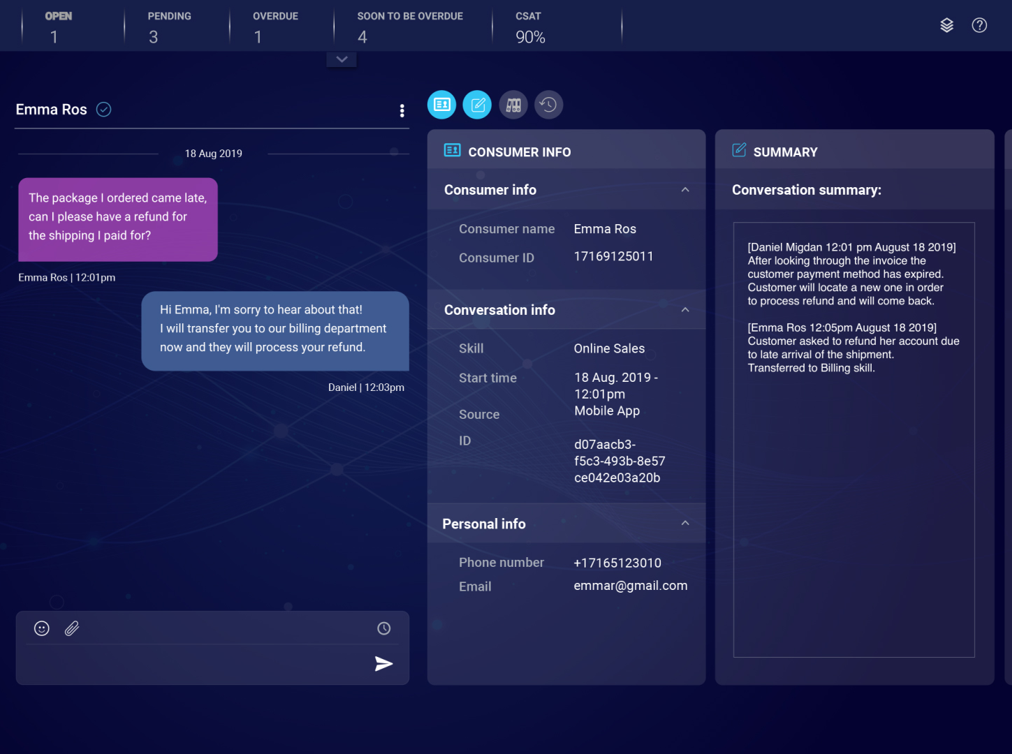
Better collaboration between agents on transferred conversations
The conversation summary widget now has space for multiple agents to leave multiple notes. This allows you to share information more easily about a conversation that is transferred from different groups or agents.

Slide 21
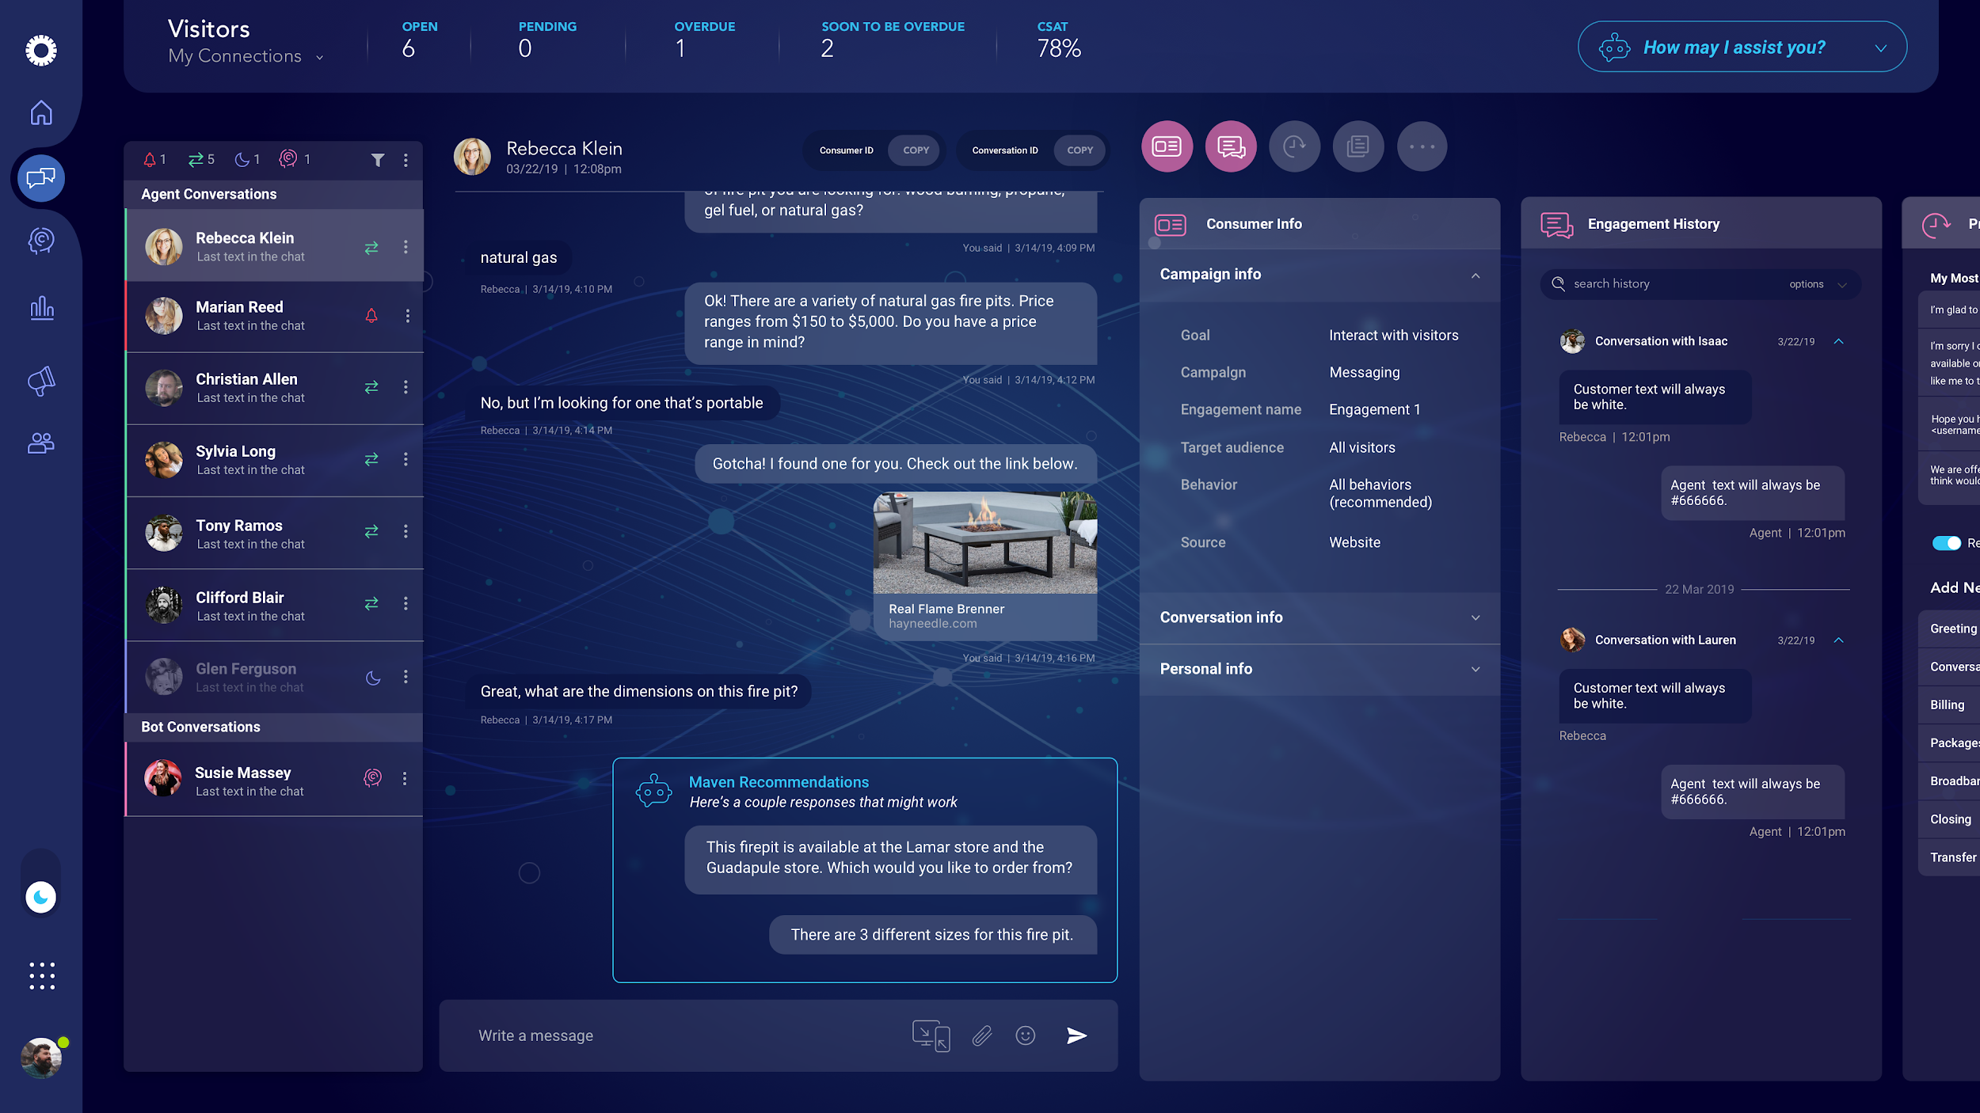
Automatic, in-line suggestions for knowledge base articles or bots
Recommended Actions by Maven appear directly in the conversation, increasing productivity by recommending the most applicable actions to you in real-time.
Recommended Actions include:
Adding a bot to the conversation
Sharing a relevant Knowledge Center article
Suggesting an agent reply
*note: this capability is not available by default. To add and configure it, please contact your LivePerson account team.
LivePerson Proprietary & Confidential Information. © 2019 LivePerson, Inc. All Rights Reserved.

Slide 22

Closing Conversations
—

Slide 23
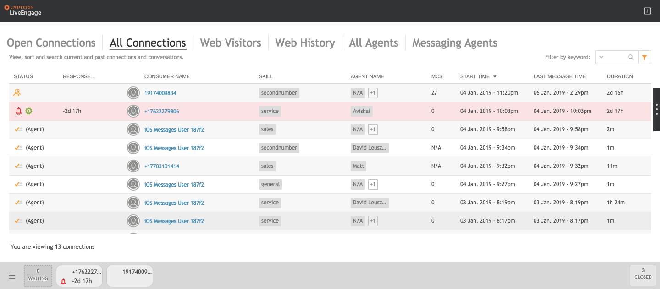
Current experience: managing closed conversations
Closed conversations previously could only be accessed in the All Connections tab and through the closed conversations box in the bottom right corner.
LivePerson Proprietary & Confidential Information. © 2019 LivePerson, Inc. All Rights Reserved.

Slide 24
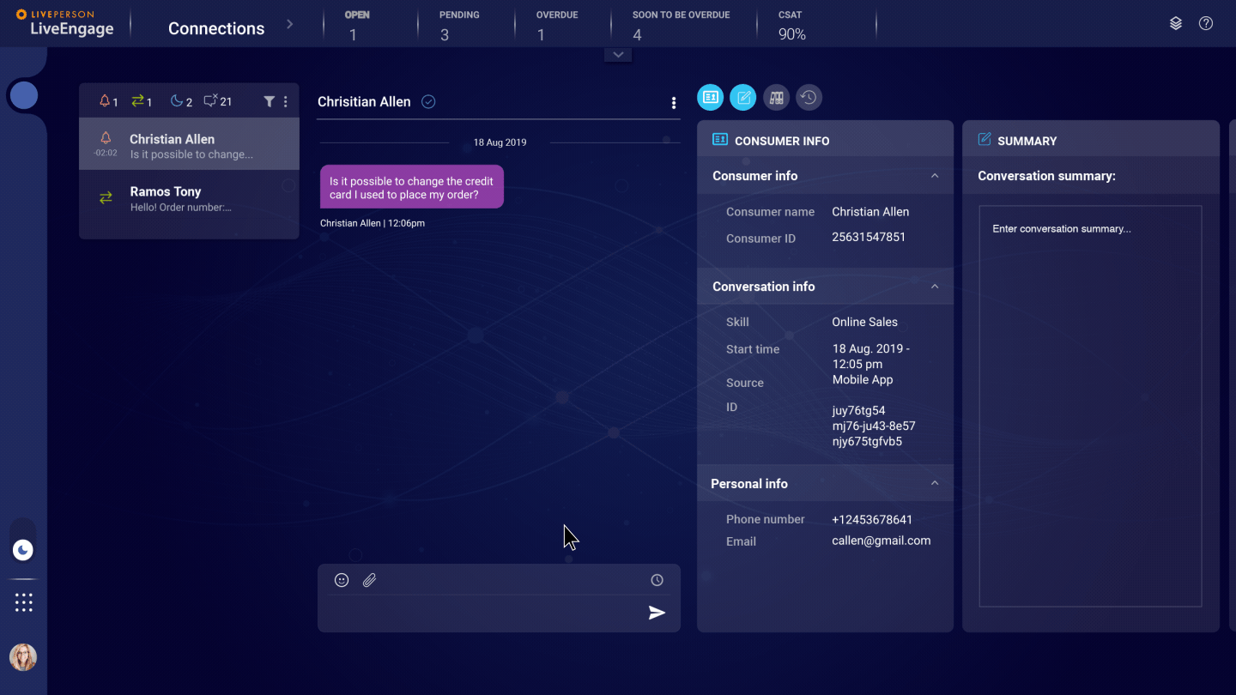
Wrap up your shift more quickly
You can now view your recently closed conversations by filtering them into the My Connections list.
At the end of your shift, filter your list to view the closed conversations to ensure you have filled out all the required documentation.

Slide 25
Additional resources
Boosting efficiency and streamlining messaging operations, the enhanced agent workspace was developed with you in mind.
For more information about working with the enhanced agent workspace, click here to view the full user guide.
LivePerson Proprietary & Confidential Information. © 2019 LivePerson, Inc. All Rights Reserved.

Slide 26
—

